Slide 1
Tasteful Panthers Milestone 1
Team Members
Alex Laureano
Jiahao Shu
Anthony Hordesky
Lexi Franklin
Faculty Advisor
Philip Chan

Slide 2
Task Matrix for Milestone 1
Task | Completion | Alex | Jiahao | Anthony | Lexi
Compare and Contrast Technical Tools | 100% | Web/Information Scraping | IDE | Database | IDE
Tool Demos | 100% | Web/Information Scraping | IDE, | Database | IDE
Resolve Technical Challenges | 80% | Swift, sorting algorithm | Swift, sorting algorithm | Swift, algorithm, encryption/decryption | Swift, sorting algorithm
Collaboration Tools | 100% | Communication | Documents/presentations | Software development | Task calendar
Requirements Document | 99% | Write 40% | Write 20% | Write 20% | Write 20%
Design Document | 99% | Write 20% | Write 20% | Write 20% | Write 40%
Test Plan | 99% | Write 20% | Write 20% | Write 40% | Write 20%

Slide 3
Task 1: Compare and Contrast Technical Tools
Flutter, programming in Dart for cross platform mobile development (iOS AND Android now)
Chose Google Firebase as our database due to functionalities like:
Cloud capabilities
Firebase Realtime Database

Slide 4
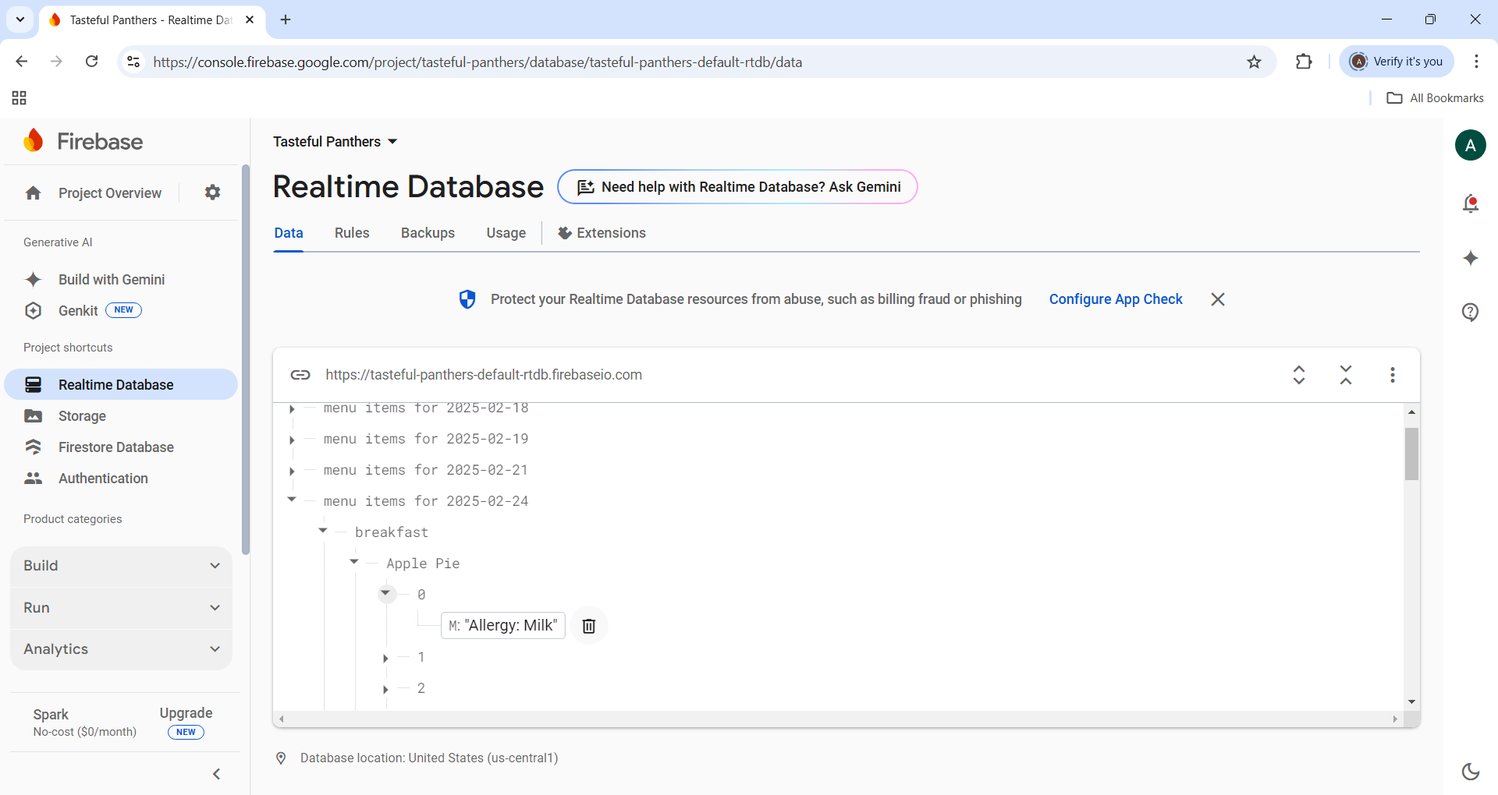
Task 2: Demos
Scraping menu items and storing them in database

Slide 5
Task 2: Demos
Simple Android app written in Dart (iOS theoretically looks the same)
GPS and heads-up notifications in mobile app

Slide 6
Task 2: Demos
Database integration with mobile app

Slide 7
Task 3: Resolve Technical Challenges
2 out of the 4 of us have a Mac, so Swift dev and testing was going to be difficult for half of us
Switched to Dart, which is the programming language for Flutter
Flutter is a cross-platform framework that will allow us to create both an Android and iOS application
We all successfully set up Flutter SDK and experimented programming in Dart

Slide 8
Task 4: Collaboration Tools
Discord and iMessages for communication
Google Docs for documentation
GitHub for software dev
No specific IDE, either VSCode or XCode depending on our systems since both support Flutter dev

Slide 9
Task 5: Requirements Document
Wrote the requirements doc that covers purpose, scope, user characteristics, etc.
In depth list of requirements for guests and staff including:
Functional requirements:
Review/suggestion creation
Flag raising/resolution
Interface requirements:
Login/signup interface
Dashboard
Performance requirements
Performance benchmarks
“This feature completes/returns within this many seconds”

Slide 10
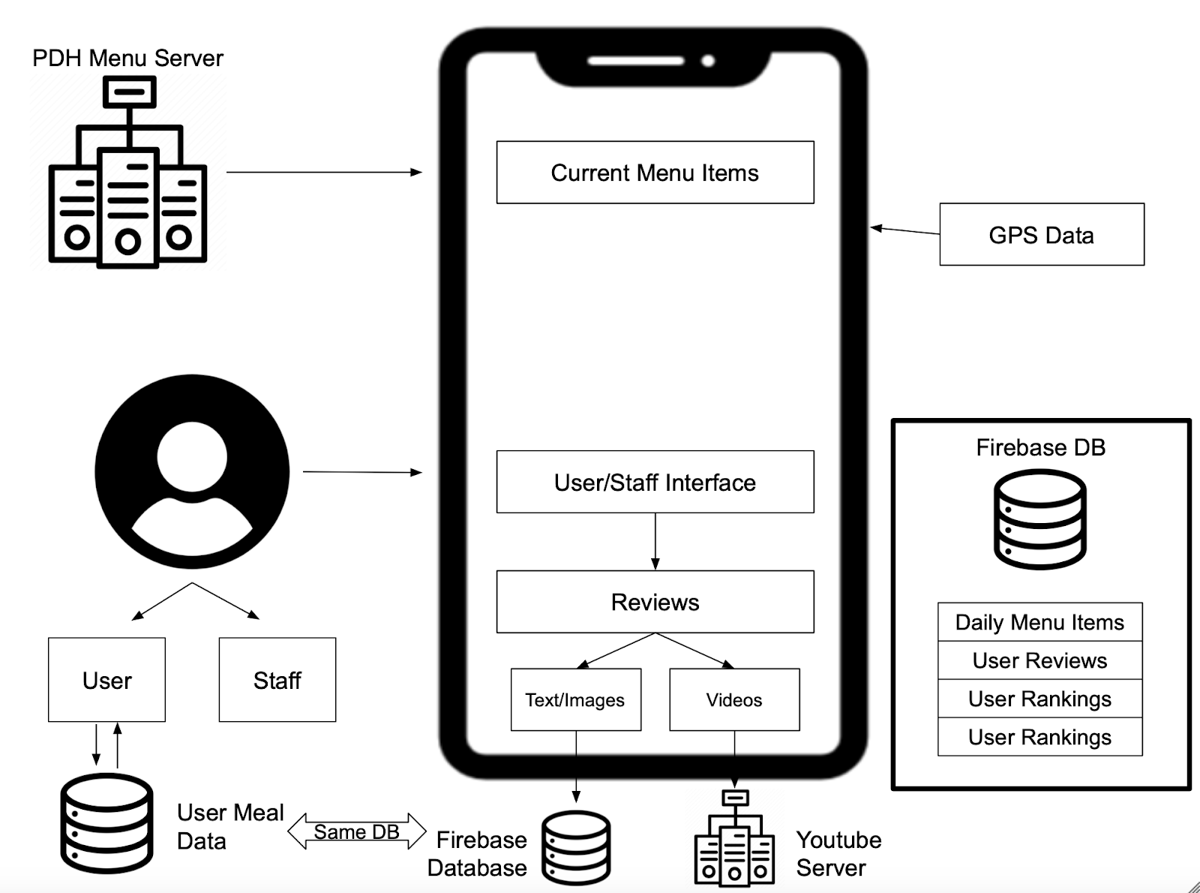
Task 6: Design Document
System Architecture Diagram

Slide 11
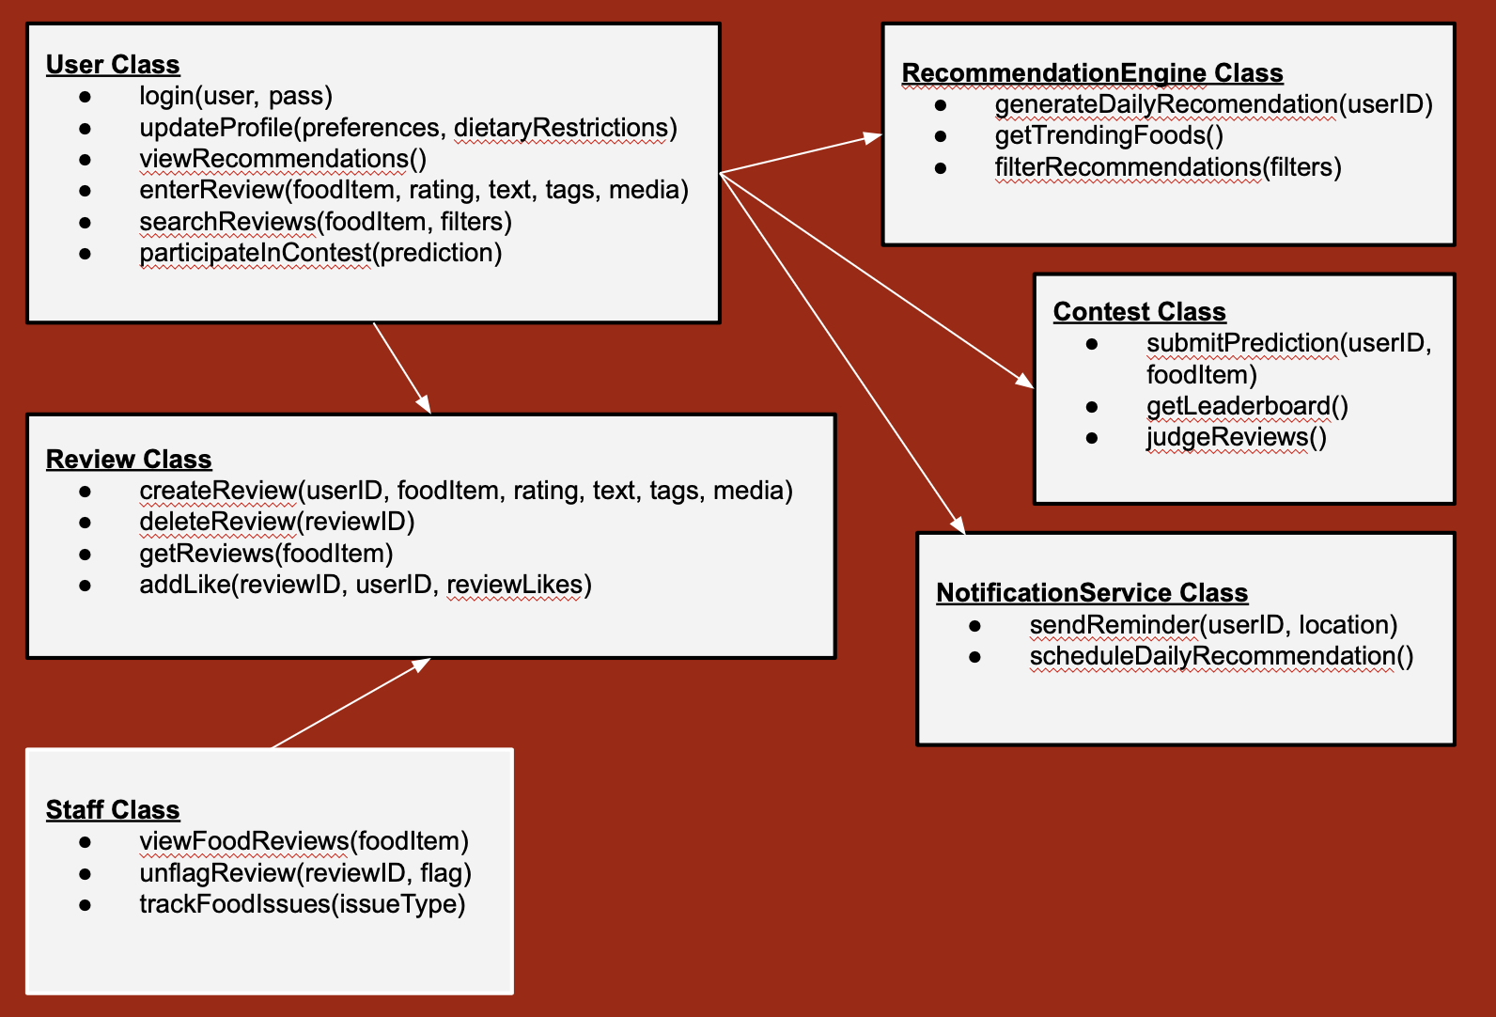
Task 6: Design Document
ER Database Diagram

Slide 12
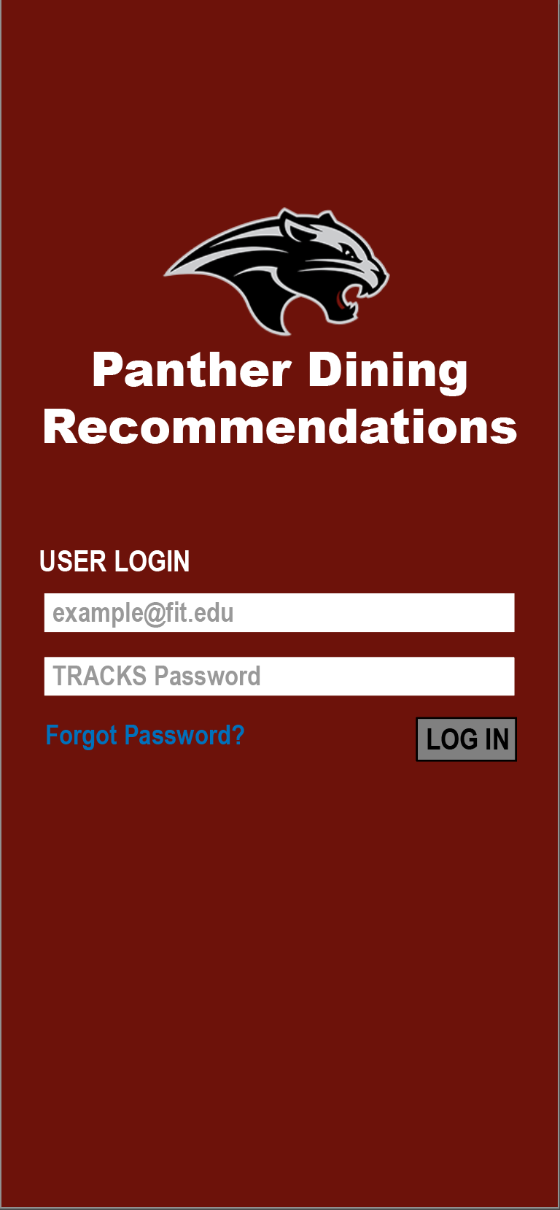
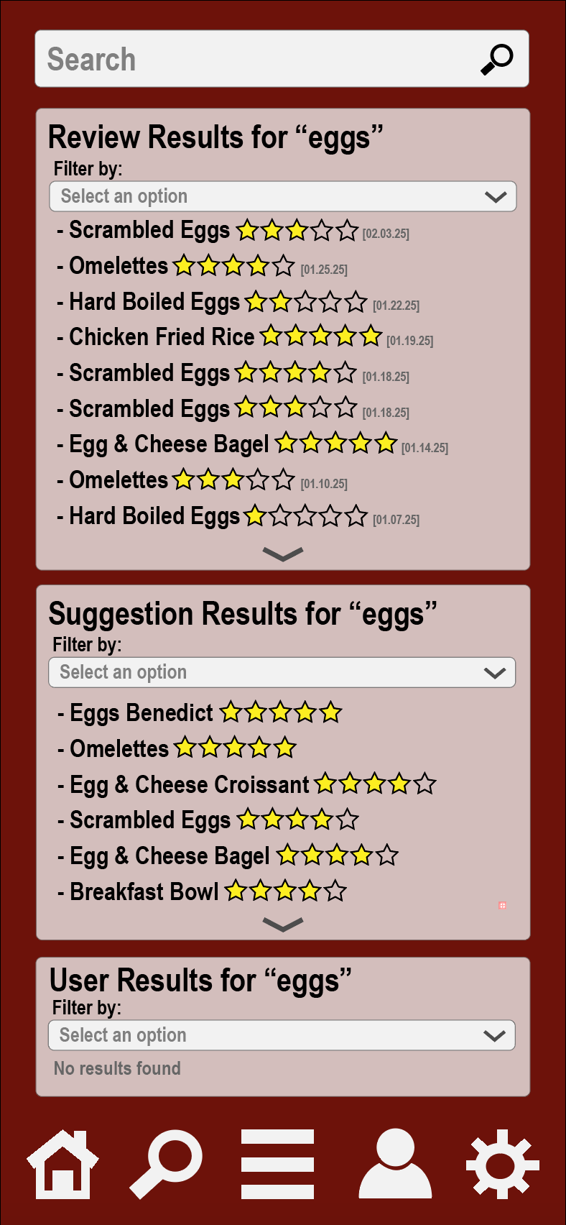
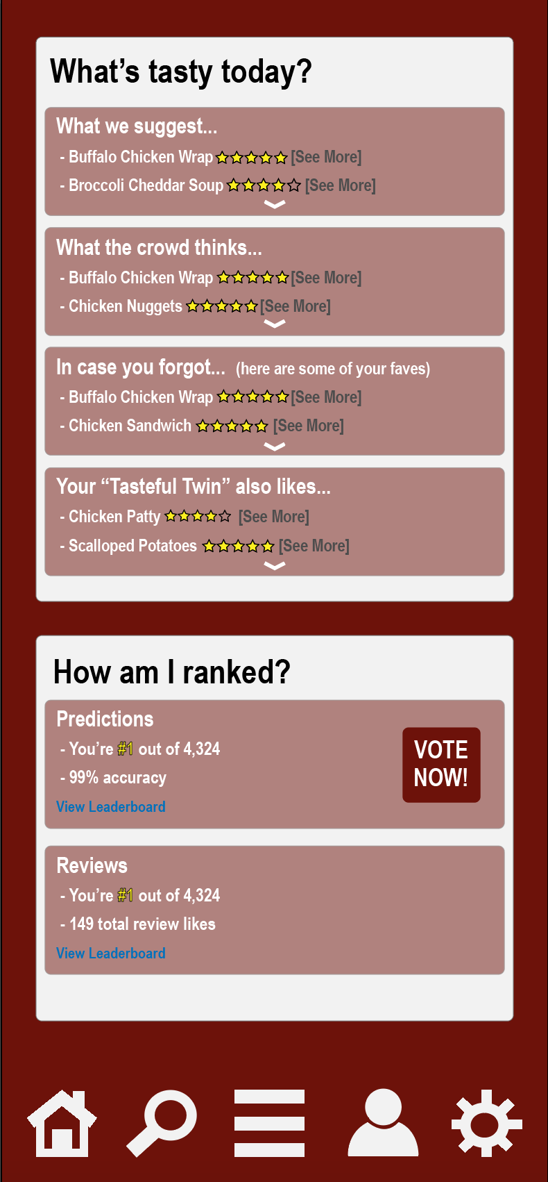
Task 6: Design Document
GUI Mockup
Login screen
Search tool
Guest dashboard

Slide 13
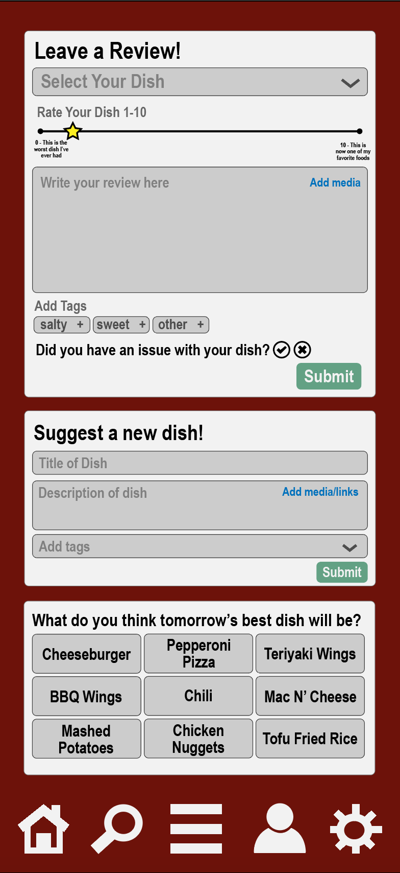
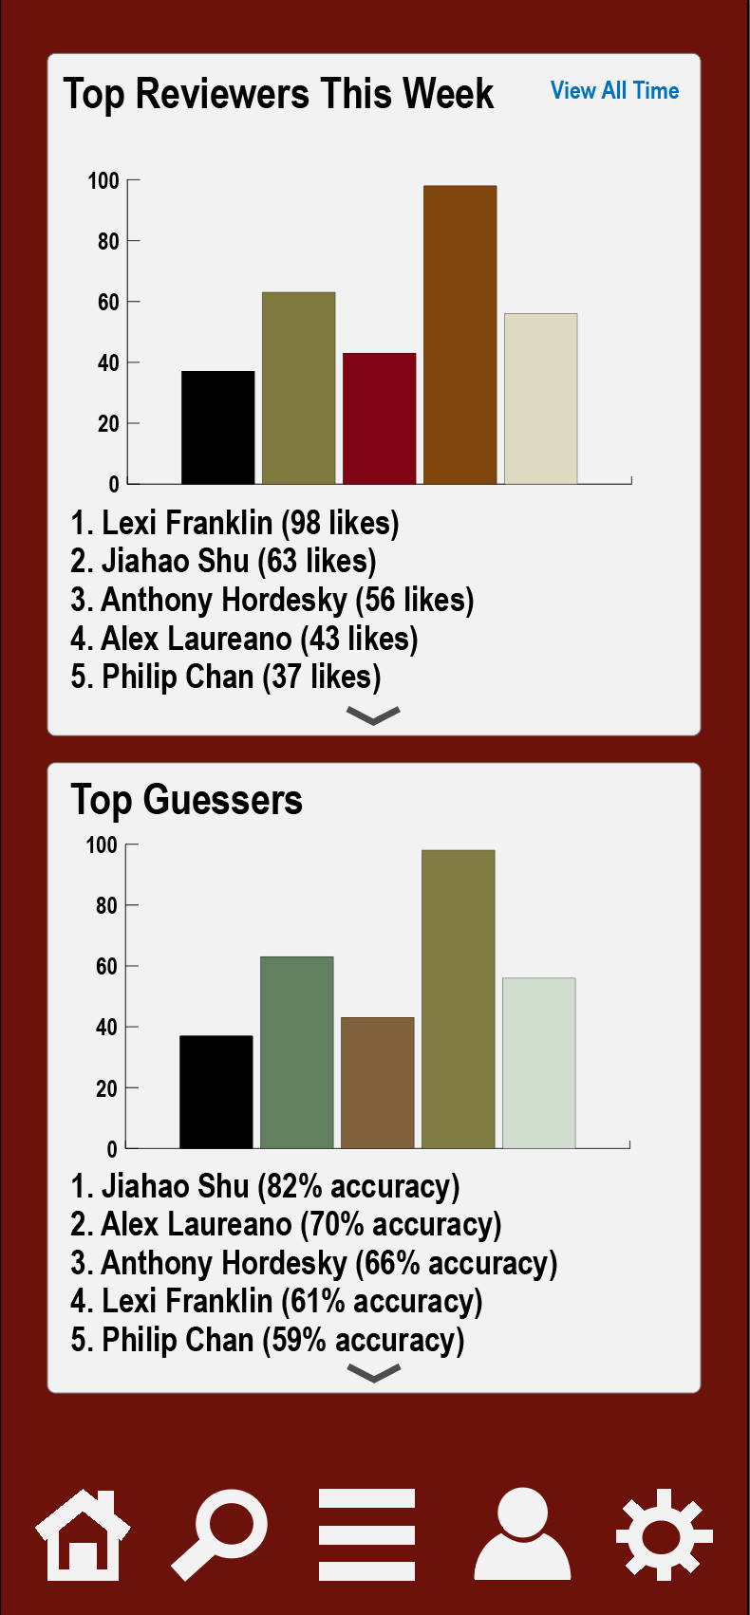
Task 6: Design Document
GUI Mockup
Review creation
Leaderboards

Slide 14
Task 7: Test Document
Test cases for covering the requirements document
Following table format:
Test Case ID | Reference Number | Requirement | Input | Expected Output
TC-PC-001 | 3.1.1.1.1 | Profile Creation (Guests) | Guest enters valid PAWS credentials and selects dietary preferences | Reviewer profile is created with a unique username and saved dietary preferences
TC-PC-002 | 3.1.1.1.1 | Profile Creation (Guests) | Guest enters invalid PAWS credentials | Profile creation fails with an error message
TC-PMR-001 | 3.1.1.2.1 | Meal Recommendations | Guest has previous meal reviews and dietary preferences set | Personalized meal recommendations appear in the app and via notifications
TC-GPS-001 | 3.1.1.2.2 | GPS-Based Recommendations | Guest enters PDH with location services enabled | Meal recommendation notification is sent upon arrival

Slide 15
Milestone 2 Task Matrix
Task | Alex | Anthony | Jiahao | Lexi
Dev & Demo Accounts | 40% | 20% | 20% | 20%
Dev & Demo Web Scraping | 20% | 40% | 20% | 20%
Dev & Demo Mobile Reviewing | 20% | 20% | 20% | 20%
Dev & Demo Database | 20% | 20% | 40% | 20%

Slide 16
Thanks
Questions?

